Slide 1
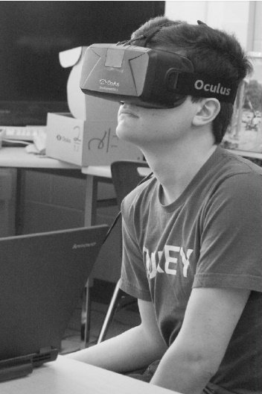
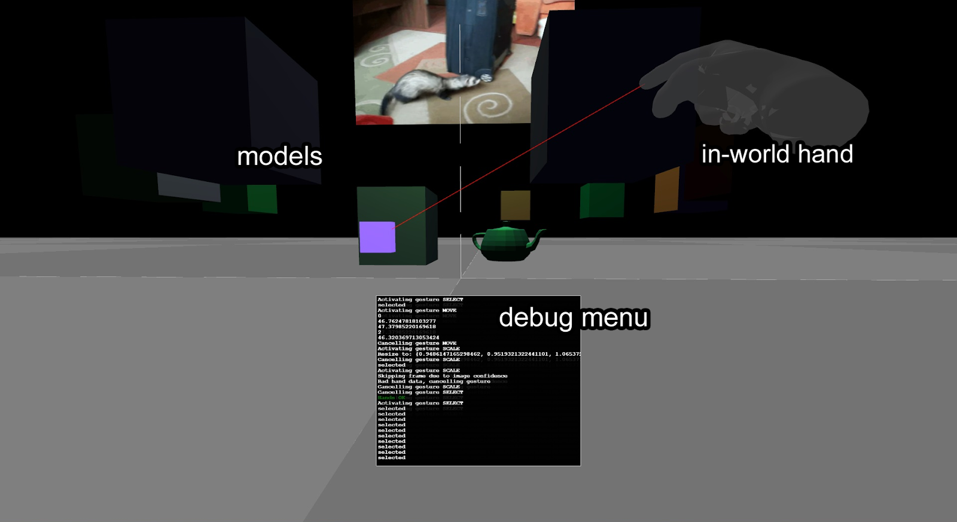
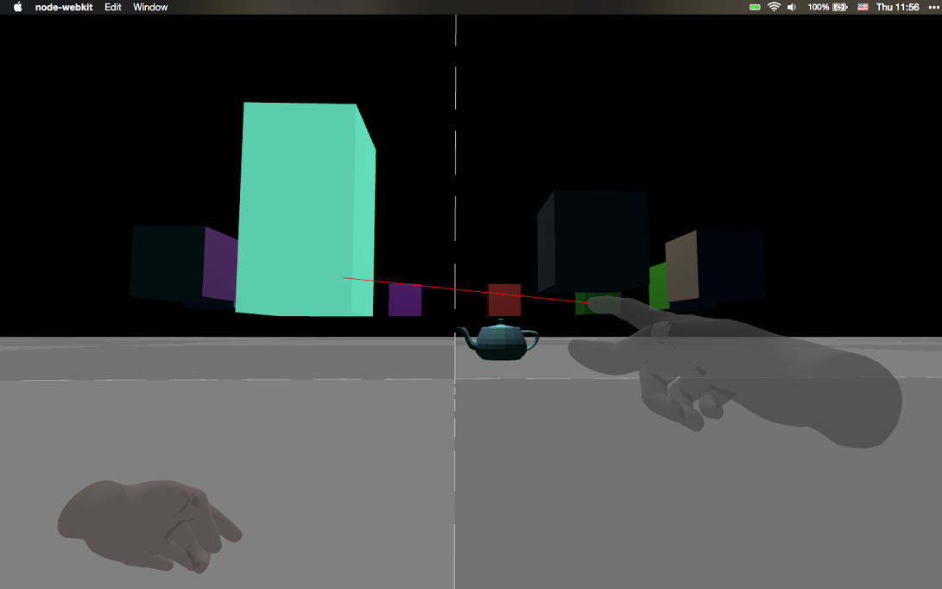
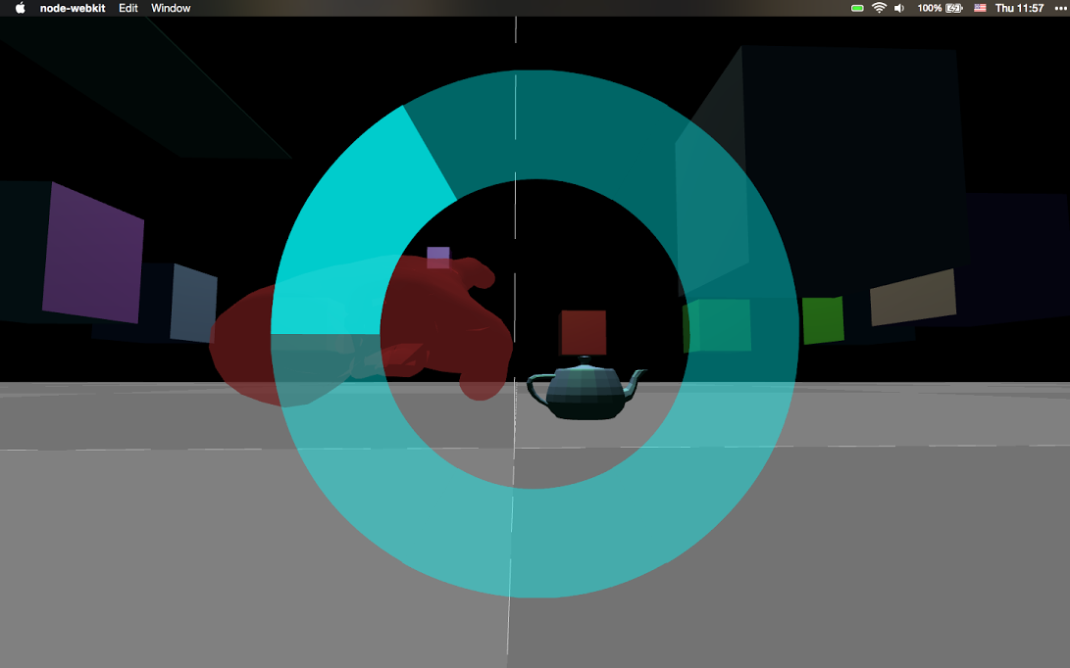
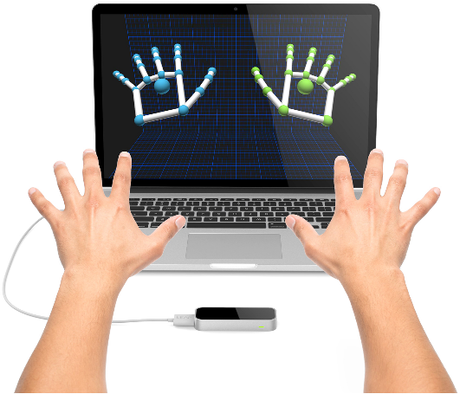
3-D Modeling with the Oculus Rift and Leap Motion
Computer Systems Research Project 2014-2015
Thai Le, Austin Ly, Ellis Tsung, Jonathon Vogel
Background and Mission
Hardware
Current industry-standard computer-aided design (CAD) software limitations forces users to use a 2-D display device and 2-D input method.
We set about to create an intuitive virtual reality wherein users could truly have a “hands-on” modelling experience.
Oculus Rift: A head-mounted display through which users enter their virtual reality.
Leap Motion Controller: A sensor that tracks a user’s hands and fingers and, with our project’s code, translates them on-screen to interact with virtual world objects.
Features
Use of hand gestures to manipulate models
Manipulations include:
Re-shaping
Re-location
Immersive experience
In-world hand models
Mimics real-world hand movements
In-world debug menu
Alerts users of gesture activation and de-activation
In-world movement
Step-by-step tutorial
Initial program run starts in-world tutorial program
Geometric object models
Examples include:
Cubes
Cylinder
Torus
Initial program run displays ring of cubes
Miscellaneous
Laser pointer assists object selection
Ability to import .obj files
Preview
Acknowledgements
Special thanks to Dr. Peter Gabor, Mr. Michael Stueben, and Dr. Shane Torbert for their indispensable supervision and guidance. This project would not have been possible without their support.

